Slide 1
COMPUTER NETWORK
TWISTED PAIR

Slide 2
TRANSMISSION MEDIA
Transmission media is a communication channel that carries the information from the sender to the receiver. Data is transmitted through the electromagnetic signals.
The main functionality of the transmission media is to carry the information in the form of bits through LAN(Local Area Network).
It is a physical path between transmitter and receiver in data communication.
In a copper-based network, the bits in the form of electrical signals.
In a fibre based network, the bits in the form of light pulses.

Slide 3
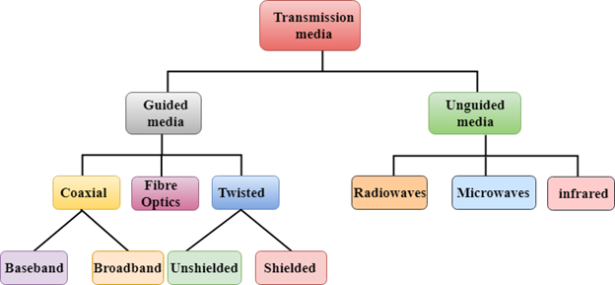
DIAGRAM OF TRANMISSION MEDIA

Slide 4
Guided Media
It is defined as the physical medium through which the signals are transmitted.
It is also known as Bounded media.

Slide 5
Twisted pair:
Twisted pair is a physical media made up of a pair of cables twisted with each other.
A twisted pair cable is cheap as compared to other transmission media.
Installation of the twisted pair cable is easy, and it is a lightweight cable.
The frequency range for twisted pair cable is from 0 to 3.5KHz.
A twisted pair consists of two insulated copper wires arranged in a regular spiral pattern.

Slide 6
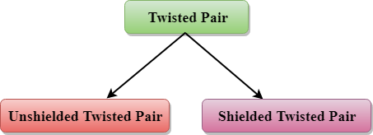
TWISTED PAIR

Slide 7
Unshielded Twisted Pair
An unshielded twisted pair is widely used in telecommunication. Following are the categories of the unshielded twisted pair cable:
Category 1: Category 1 is used for telephone lines that have low-speed data.
Category 2: It can support upto 4Mbps.
Category 3: It can support upto 16Mbps.
Category 4: It can support upto 20Mbps. Therefore, it can be used for long-distance communication.
Category 5: It can support upto 200Mbps.

Slide 8
Shielded Twisted Pair
A shielded twisted pair is a cable that contains the mesh surrounding the wire that allows the higher transmission rate.
Characteristics Of Shielded Twisted Pair:
The cost of the shielded twisted pair cable is not very high and not very low.
An installation of STP is easy.
It has higher capacity as compared to unshielded twisted pair cable.
It has a higher attenuation.
It is shielded that provides the higher data transmission rate.

